Slide 1

Software design
Database and Software Technology
Group 1
？？2020

Slide 2
OUTLINE
Introduction
document output
document description
Design Considerations
dependencies
general constraints
goals and guidelines
development methods
Architectural Strategies
System Design
Notes:
This is the outline.

Slide 3
Introduction

Slide 4
Aim
A web application which provides accurate drug query (drug dose, label, detailed information), and gives suggestions of disease-related drugs based on the analysis of VCF file provided by the user.
Introduction

Slide 5
Overview of the software design procedure
relevant packages and dependencies deployment
architecture build
detailed function realization
limitation improvement
Introduction

Slide 6
document output
give a drug recommendation based on the diagnosis of the presence of clinically relevant genetic variants (Annovar process)
display the Lists of drug information obtained from pharmGKB, which consists of drug list, drug label list and dosing guideline list.
Return information about the drug and dosage based on the drug id being queried.
Introduction

Slide 7
Design considerations

Slide 8
dependencies
The java IDE: intelliJ IDEA
The implementation of the Java Servlet: Apache Tomcat
The software project management and comprehension tool: Apache Maven
Java database connectivity tool: Oracle JDBC
Framework writing repeatable tests: Junit
The css framework: Bootstrap
Design considerations
Notes:
Plus, in order to import the data downloaded from pharmGKB, we use Gson to convert JSON strings to equivalent Java objects. Meanwhile, for file upload, we use the comments fileupload package to upload the tsv file which is the output file of annovar process.

Slide 9
general constraints
cannot be accessed by other computers ---- practicability
the drug search function is limited ---- practicability & convenience
the user’s history query will be very low if the number of users is large ---- performance
cannot update the drug information in time ---- accuracy
cannot support users with password recover function ---- convenience
the code has some redundancy which can be further improved ---- performance
Design considerations

Slide 10
goals
provide a general drug information knowledgebase.
Provide sequence analysis and diagnosis of the presence of clinically relevant genetic variants and make a drug and dosage recommendation for either the patient, the doctor, or the researcher.
Design considerations

Slide 11
development methods
Object-Oriented software developing technique
Bottom-up and top-down approach
Based on object modeling, which considers not only the input and output data structures, but actually the data structures of all objects.
Furthermore, OO technology has made substantial breakthroughs in requirements analysis, maintainability, and reliability, three key aspects and quality indicators of software development
Design considerations

Slide 12
architectural strategies

Slide 13
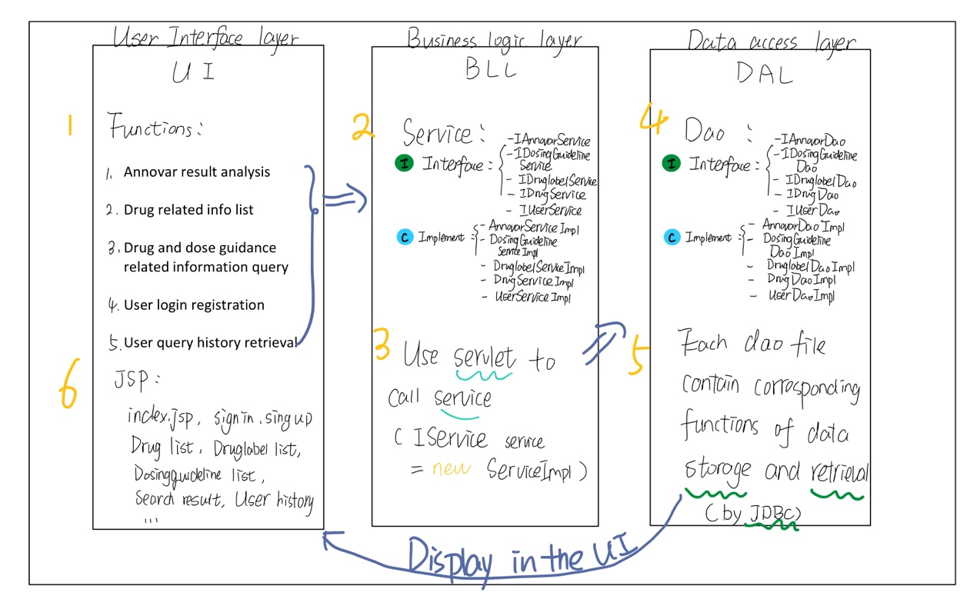
architectural strategies
Notes:
first, we used the three layer architecture, the first the second the third... and I will explain this in detail later

Slide 14
system design

Slide 15
system design
We plan to design five major functions for the drug guidance software, including annovar result analysis, drug related information list, drug and dose guidance related information query, user login registration, user query history retrieval.
system design

Slide 16
system design
Notes:
The implementation of the function adopts the software architecture pattern of 3-tier architecture, we construct the UI (User Interface layer) layer through the research and analysis of requirements, and then call the service in the BLL (Business Logic Layer), in turn the BLL call the DAl (Data access layer) layer, realize the database call, and finally return the data to display in the user interface.

Slide 17
system design
Notes:
For the UI layer, in addition to the index page, there should be six main pages corresponding to the six functions.

Slide 18
system design
Notes:
For the BLL layer, we use the servlet to call the service in the BLL layer, and the DAl layer entity function was called through the interface

Slide 19
system design
Notes:
For the DAL layer, The Dao (DataAccessObjects) files corresponding to the five functions should contain entity functions such as data storage and retrieval, and connect to the database through JDBC to achieve data operation.
Finally, the retrieved information is displayed on the corresponding page of the user interface.

Slide 20
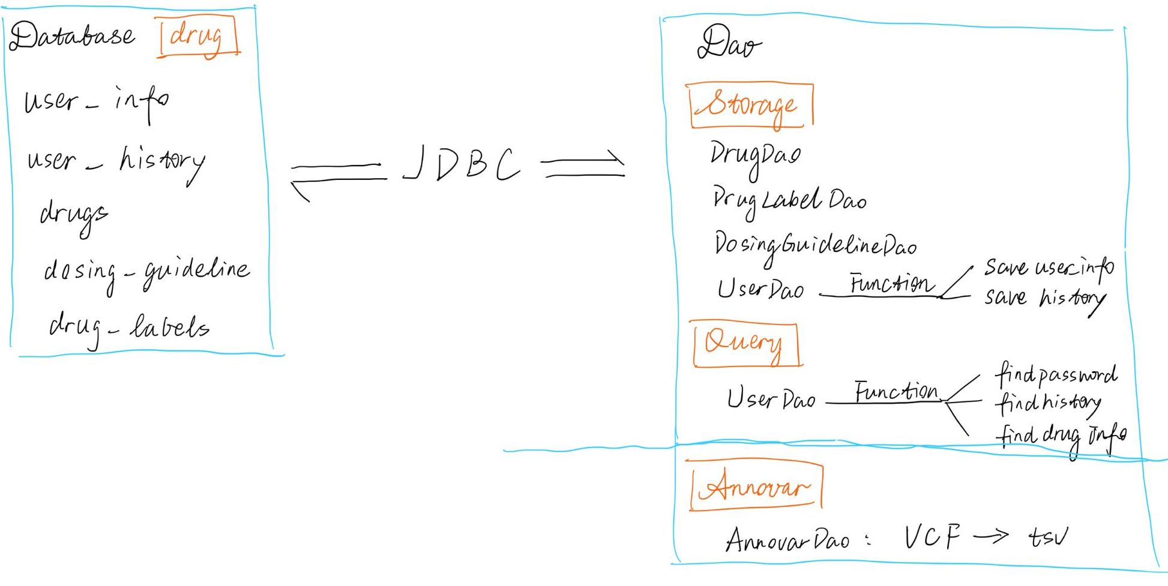
Notes:
for the connection of database, here you can see that, the dao files are connected to the relavent dataset by JDBC, and there are four dao files,1,2,3,4, and all of them include a data storage function, plus, the userdao have query functions, the first one, find password is used to match the current user, and findhistory to find the search history of this matched user, the finddruginfo is used to find the information of the drugs which the user have searched.
and for the annovar part, we plan to construct a annovardao to save the data and retrieval the annovar results then put them on the page.

Slide 21
Achieve the goals
provide a general drug information knowledgebase.
Provide sequence analysis and diagnosis of the presence of clinically relevant genetic variants and make a drug and dosage recommendation for either the patient, the doctor, or the researcher.

Slide 22
Thank you
Group 1

